Slide 1
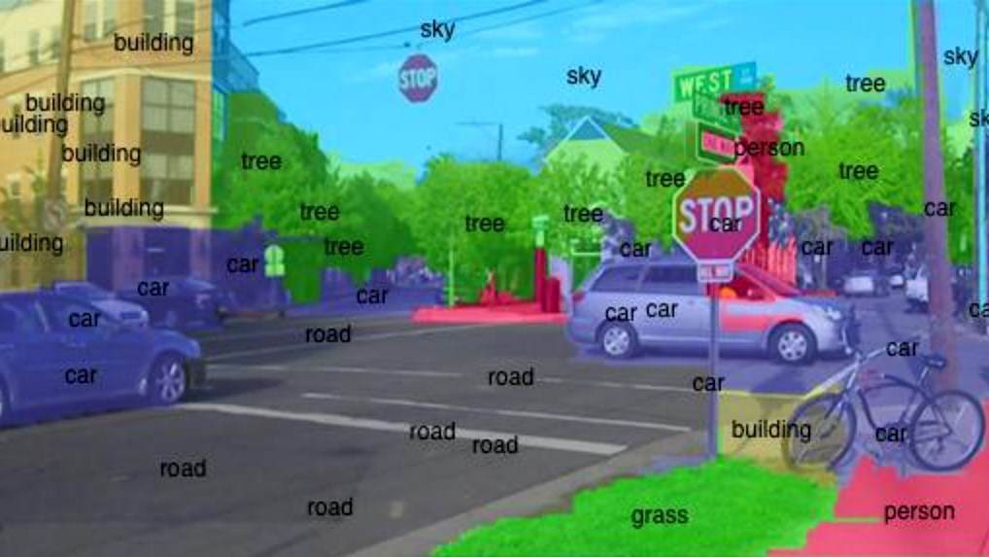
Intro to Computer Vision
Yoni Chechik
Computer Vision course

Slide 2
contents
Course details
What is computer vision (CV)?
Course outline
Intro to Python

Slide 3
References
Lectures Based on the book: Computer Vision: Algorithms and Applications, 2010, Richard Szeliski (http://szeliski.org/Book/)

Slide 4
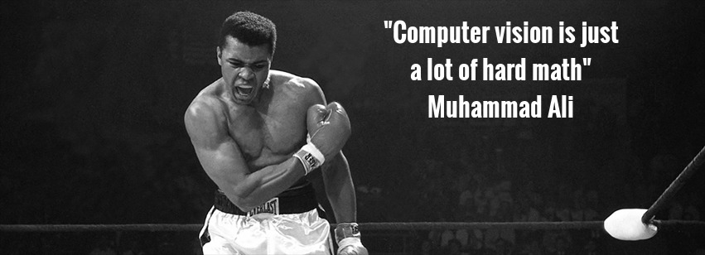
Prerequisites
No prior knowledge in signal/image processing is assumed.
Heavy use in algebra and calculus- mathematical maturity is assumed.

Slide 5
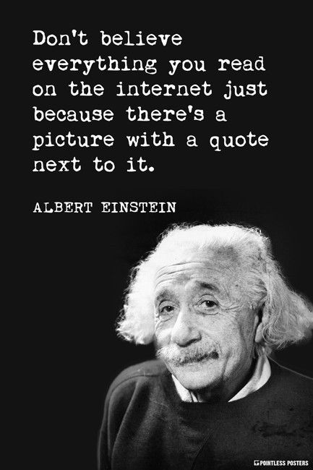
contents
Course details
What is computer vision (CV)?
Course outline
Intro to Python

Slide 6
What is CV?
Computer vision is an interdisciplinary scientific field that deals with how computers can be made to gain high-level understanding from digital images or videos. [Wikipedia]
Image processing is an umbrella term for many functions that analyze images or convert one representation of an image into another.

Slide 7
What is CV?
Output Input | Data | Image
Data | Signal processing | Computer graphics
Image | Computer vision | Image processing
Machine learning
Computer vision
Signal processing
Image processing
Computer graphics

Slide 8
Why CV?
IT’s
f***ing
cool

Slide 9
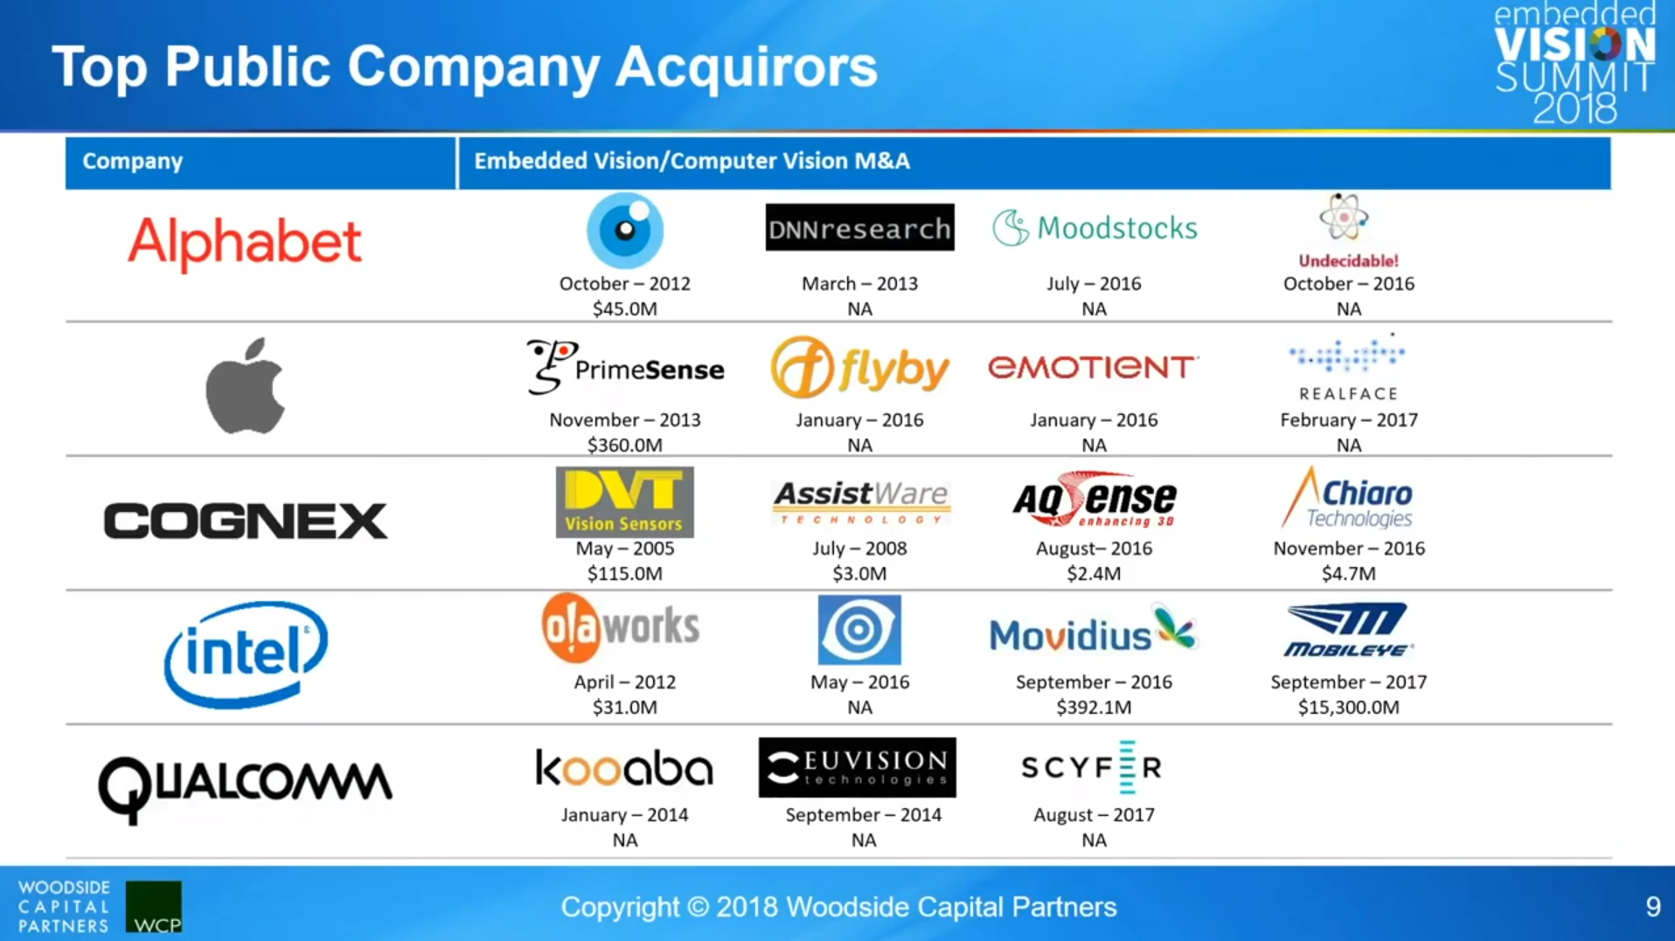
Why CV?

Slide 10


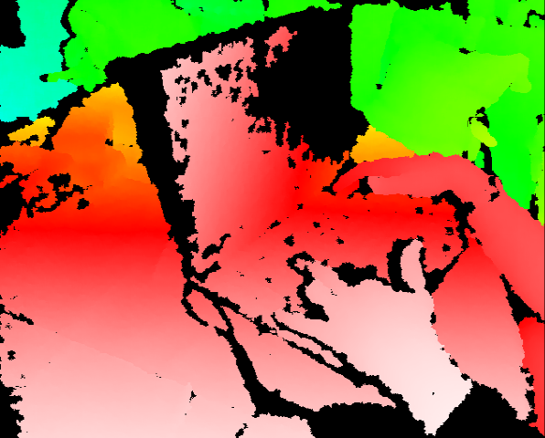
PrimeSense == Kinect
Kinect for Xbox 360: 3D scanner system using Light Coding approach for 3D reconstruction.
KinectFusion [Newcombe et al., 2011] : https://www.youtube.com/watch?v=KOUSSlKUJ-A

Slide 11
Why CV?

Slide 12
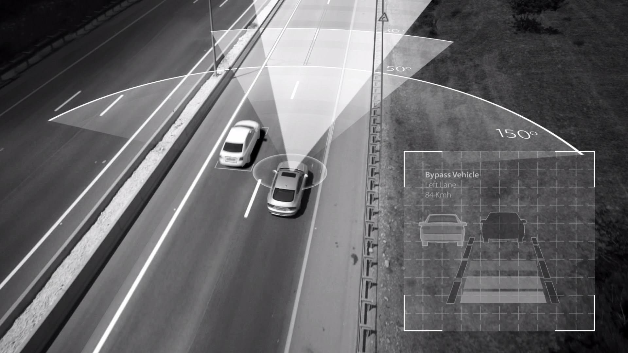
Mobileye
Mobileye is an Israeli subsidiary of Intel corporation that develops vision-based advanced driver-assistance systems (ADAS) providing warnings for collision prevention and mitigation. [Wikipedia]
https://www.youtube.com/watch?v=JDUb6CurYJM

Slide 13
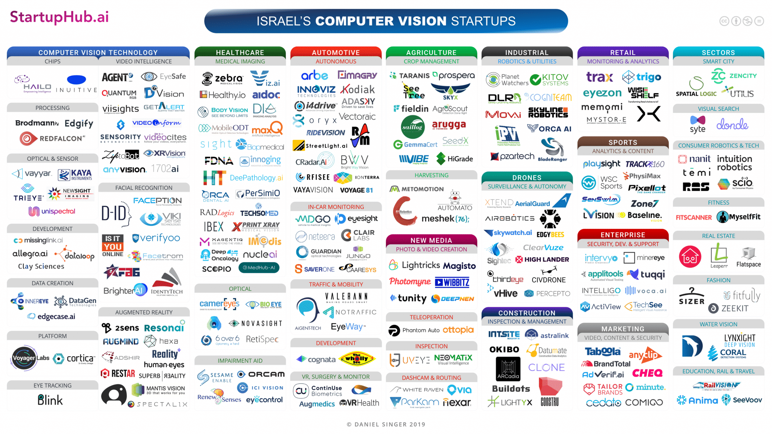
Why CV?

Slide 14

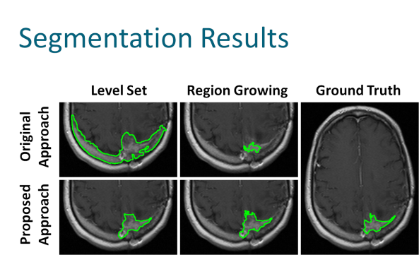
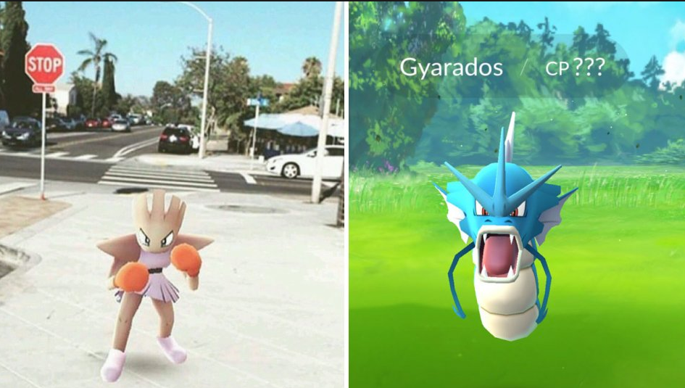
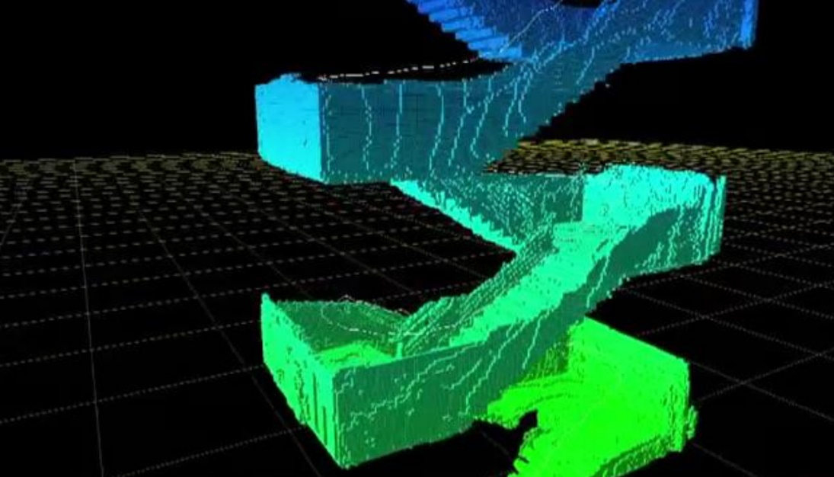
More CV related topics
Virtual/augmented reality
navigation
Gaming
medicine
And much more…

Slide 15
contents
Course details
What is computer vision (CV)?
Course outline
Intro to Python

Slide 16
Course outline
# | subject
1 | Introduction to CV + Python: numpy, matplotlib.
2 | Image processing recap: convolutions, LPF, HPF, morphology, connected components, gamma correction, histogram equalization.
3 | Edge detection: gradient (roberts, prewitt, sobel), Laplacian, DoG (derivative of Gaussian), canny edge detector.
4 | Shape detection: template matching, Hough transform.
5 | Digital cameras: image formation, transformation, interpolation.
6 | Camera calibration: extrinsic, intrinsic, radial distortion.
7 | Stereo vision: dual camera rectification, triangulation.
8 | 3D cameras: LIDAR, KINECT, structured light, planoptic
9 | Line fit: least squares, total least squares, RANSAC,
10 | Feature extraction: SIFT, image stitching (scale space).
11 | Neural networks: intro, CNN, MNIST, Alexnet.
12 | Final project 1
13 | Final project 2

Slide 17
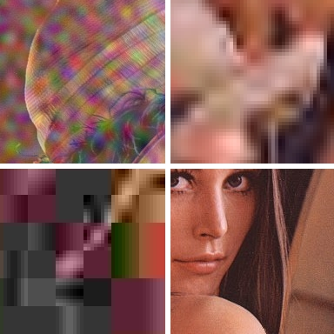
Image processing
Read more about Lenna – the standard test image: https://en.wikipedia.org/wiki/Lenna

Slide 18
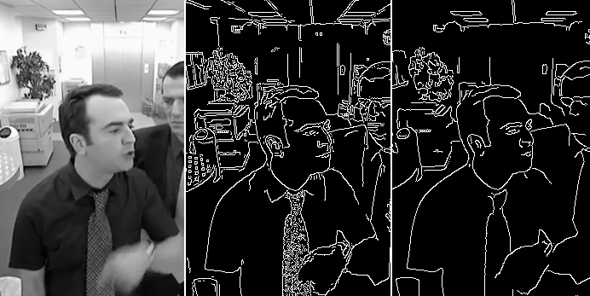
Edge Detection
https://www.youtube.com/watch?v=hQ-bpfdWQh8
https://pinetools.com/image-edge-detection

Slide 19

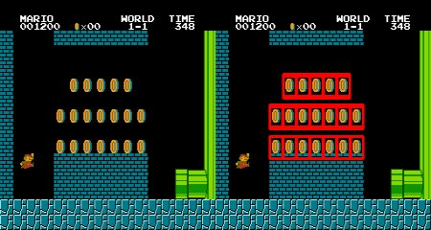
Shape detection

Slide 20
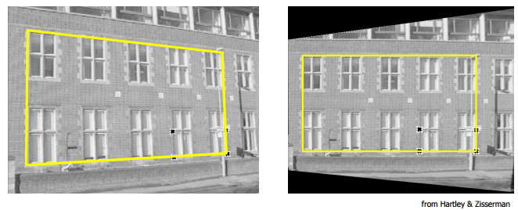
Digital cameras
Image formation: https://www.youtube.com/watch?v=dY0K65eXhkA
Transformation and interpolation.

Slide 21
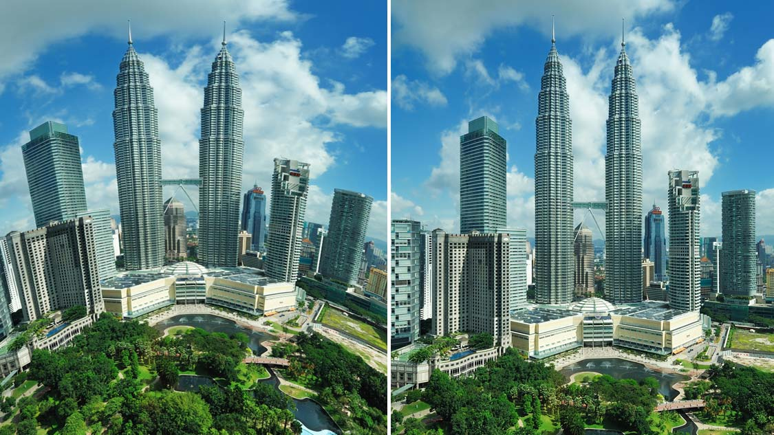
Image calibration
Fisheye correction from go-pro for example

Slide 22
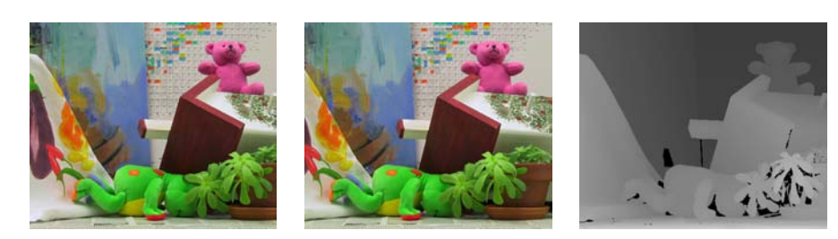
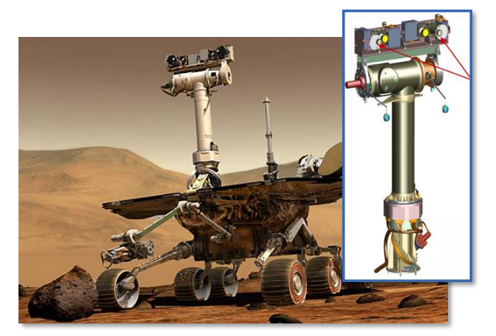
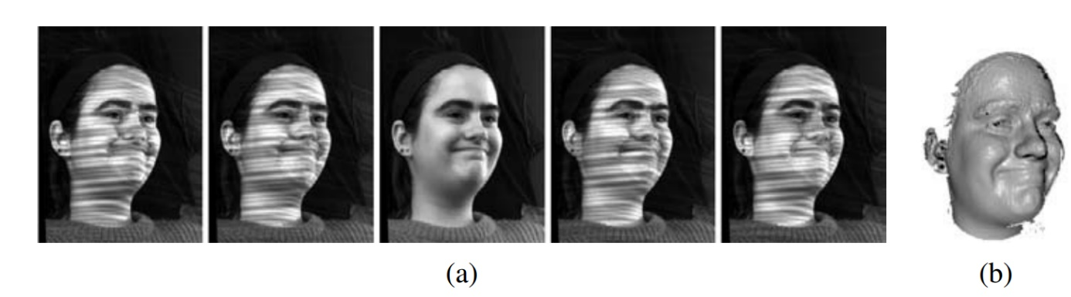
Stereo & 3d cameras
https://www.youtube.com/watch?v=PySBQ8Q_R8k

Slide 23
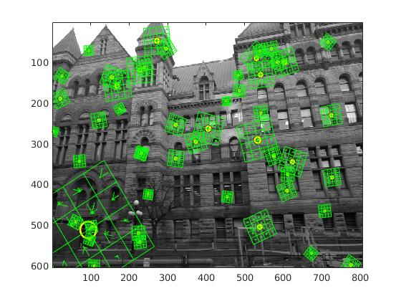
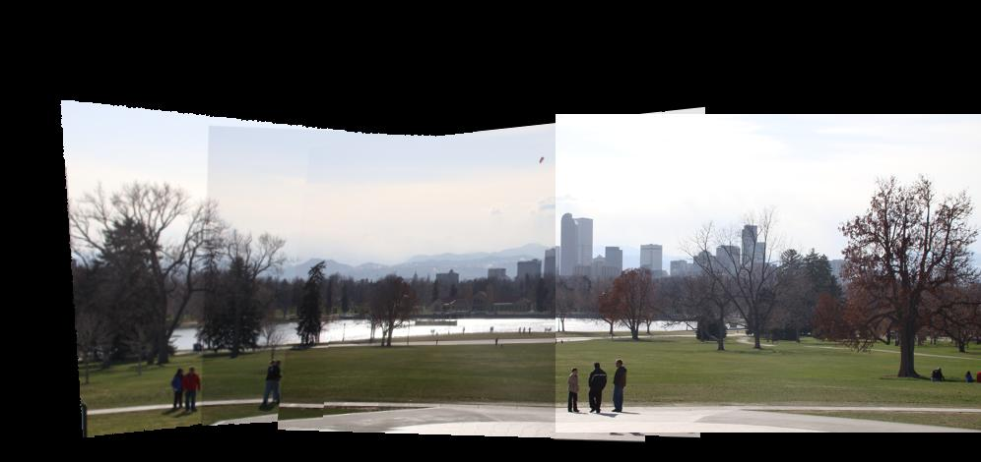
Fitting & Feature extraction
Extract interesting points from image for later recognition, stitching, learning and more.
http://www.in2white.com/

Slide 24
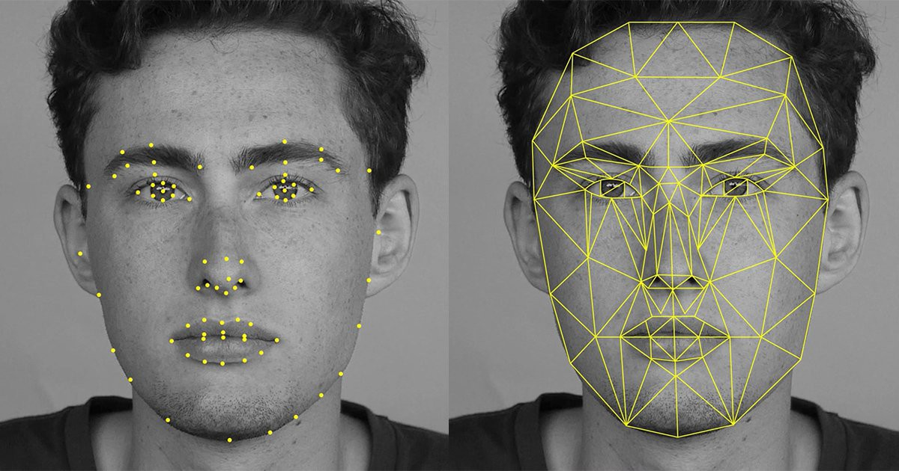
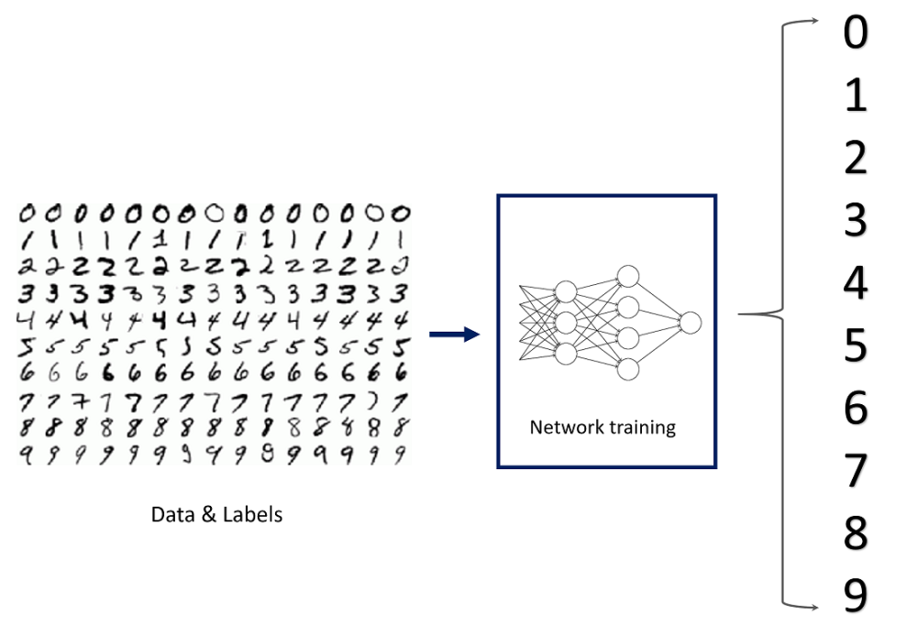
Neural networks
https://deepdreamgenerator.com/generator
https://quickdraw.withgoogle.com

Slide 25
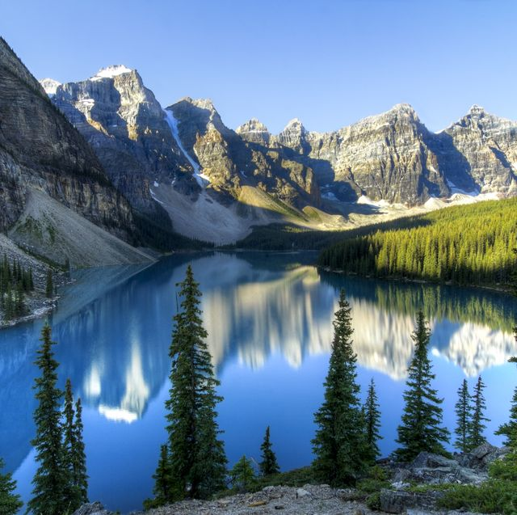
Dream generator- style transfer

Slide 26
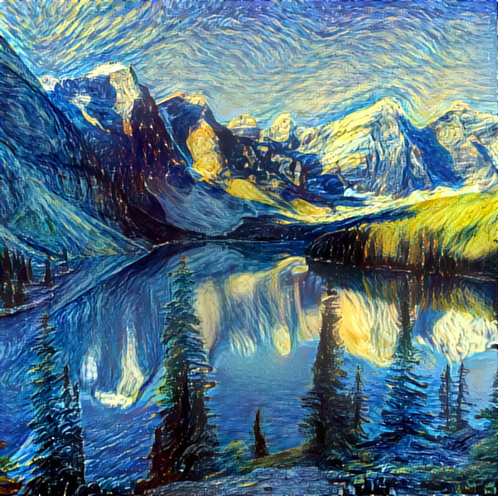
Dream generator- style transfer

Slide 27
And some more AI stuff
Deep fake
https://www.youtube.com/watch?v=cQ54GDm1eL0
https://www.youtube.com/watch?v=-QvIX3cY4lc
Nvidia GauGAN
https://www.youtube.com/watch?v=p5U4NgVGAwg&t=40s
http://nvidia-research-mingyuliu.com/gaugan

Slide 28
contents
Course details
What is computer vision (CV)?
Course outline
Intro to Python

